Slide 1
Process Models
Text Book Reference:
Roger S. Pressman, Software Engineering – A Practitioner‟s Approach, Seventh Edition, Mc Graw-Hill International Edition, 2010.

Slide 2
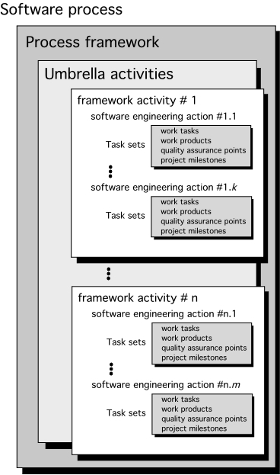
A Generic Process Model

Slide 3
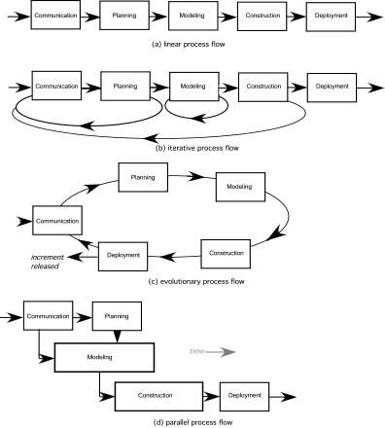
Process Flow

Slide 4
Defining a Framework Activity
A software team would need significantly more information before it could properly execute any one of these activities as part of the software process.
What actions are appropriate for a framework activity, given the nature of the problem to be solved, the characteristics of the people doing the work, and the stakeholders who are sponsoring the project?

Slide 5
Identifying a Task Set
Each software engineering action (e.g., elicitation, an action associated with the communication activity) can be represented by a number of different task sets.
A task set defines the actual work to be done to accomplish the objectives of a software engineering action.
A list of the task to be accomplished
A list of the work products to be produced
A list of the quality assurance filters to be applied

Slide 6
Process Patterns
A process pattern
describes a process-related problem that is encountered during software engineering work,
identifies the environment in which the problem has been encountered, and
suggests one or more proven solutions to the problem.
Stated in more general terms, a process pattern provides you with a template [Amb98]—a consistent method for describing problem solutions within the context of the software process.

Slide 7
Process Pattern Types
Stage patterns—defines a problem associated with a framework activity for the process.
Task patterns—defines a problem associated with a software engineering action or work task and relevant to successful software engineering practice
Phase patterns—define the sequence of framework activities that occur with the process, even when the overall flow of activities is iterative in nature.

Slide 8
Process Assessment and Improvement
Standard CMMI Assessment Method for Process Improvement (SCAMPI) — provides a five step process assessment model that incorporates five phases: initiating, diagnosing, establishing, acting and learning.
CMM-Based Appraisal for Internal Process Improvement (CBA IPI)—provides a diagnostic technique for assessing the relative maturity of a software organization; uses the SEI CMM as the basis for the assessment [Dun01]
SPICE—The SPICE (ISO/IEC15504) standard defines a set of requirements for software process assessment. The intent of the standard is to assist organizations in developing an objective evaluation of the efficacy of any defined software process. [ISO08]
ISO 9001:2000 for Software—a generic standard that applies to any organization that wants to improve the overall quality of the products, systems, or services that it provides. Therefore, the standard is directly applicable to software organizations and companies. [Ant06]

Slide 9
Capability Maturity Model Integration (CMMI)
The Software Engineering Institute (SEI) has developed process meta-model to measure organization different level of process capability and maturity.
CMMI – developed by SEI
CMMI is a collection of best practices used by software, hardware, IT development, and service organizations to improve their cost, schedule and quality results.
The CMMI defines each process area in terms of “specific goals” and the “specific practices” required to achieve these goals.
Specific goals establish the characteristics that must exist if the activities implied by a process area are to be effective.
Specific practices refine a goal into a set of process-related activities.

Slide 10
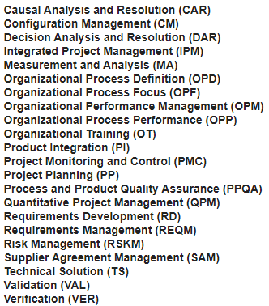
Specific Practices

Slide 11
CMMI Level
Level 0 (Incomplete) –
Process are not perform or not achieve all the goals and objectives defined by the CMMI for Level I capability.
Level 1 (Performed) – All specific goals are performed as per defined by CMMI
Level 2 (Managed) –
All level 1 criteria have been satisfied
In addition to Level I;
People doing work have access to adequate resources to get job done,
Stakeholders are actively involved,
Work tasks and products are monitored, controlled, reviewed, and evaluated for conformance to process description.
Level 3 (Defined) –
All level 2 criteria have been achieved.
In addition;
management and engineering processes documented
standardized and integrated into organization-wide software process

Slide 12
CMMI Level (cont.)
Level 4 (Quantitatively Managed) -
All level 3 criteria have been satisfied.
Software process and products are quantitatively understood
Controlled using detailed measures and assessment.
Level 5 (Optimized) –
Continuous process improvement is enabled by quantitative feedback from the process and testing innovative ideas.

Slide 13
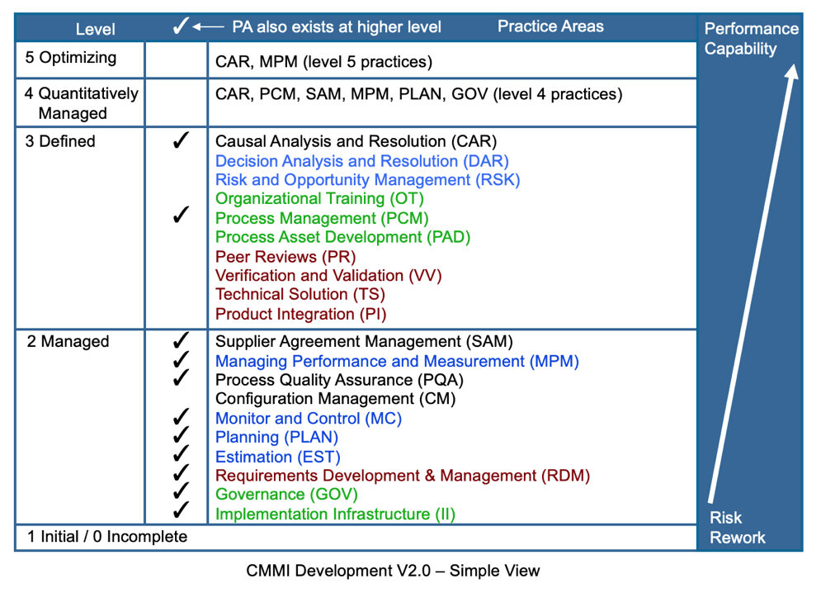

Slide 14
Software process model
Process models prescribe a distinct set of activities, actions, tasks, milestones, and work products required to engineer high quality software.
Process models are not perfect, but provide roadmap for software engineering work.
Software models provide stability, control, and organization to a process that if not managed can easily get out of control
Software process models are adapted to meet the needs of software engineers and managers for a specific project.

Slide 15
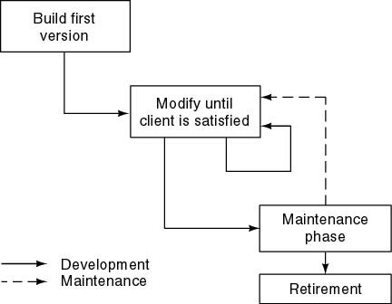
Build and Fix Model

Slide 16
Build and Fix Model
The earlier approach
Product is constructed without specification or any attempt at design.
developers simply build a product that is reworked as many times as necessary to satisfy the client.
model may work for small projects but is totally unsatisfactory for products of any reasonable size.
Maintenance is high.
Source of difficulties and deficiencies
impossible to predict
impossible to manage

Slide 17
Prescriptive Process Models
Prescriptive process models advocate an orderly approach to software engineering
Organize framework activities in a certain order
Process framework activity with set of software engineering actions.
Each action in terms of a task set that identifies the work to be accomplished to meet the goals.
The resultant process model should be adapted to accommodate the nature of the specific project, people doing the work, and the work environment.
Software engineer choose process framework that includes activities like;
Communication
Planning
Modeling
Construction
Deployment

Slide 18
The Waterfall Model/Classical Model/ Linear Model

Slide 19
Waterfall Model or Classic Life Cycle
Requirement Analysis and Definition: What - The systems services, constraints and goals are defined by customers with system users.
Scheduling tracking -
Assessing progress against the project plan.
Require action to maintain schedule.
System and Software Design: How –It establishes and overall system architecture. Software design involves fundamental system abstractions and their relationships.
Integration and system testing: The individual program unit or programs are integrated and tested as a complete system to ensure that the software requirements have been met. After testing, the software system is delivered to the customer.
Operation and Maintenance: Normally this is the longest phase of the software life cycle. The system is installed and put into practical use. Maintenance involves correcting errors which were not discovered in earlier stages of the life-cycle.

Slide 20
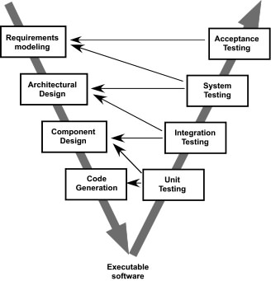
The V-Model
V
E
R
I
F
I
C
A
T
I
O
N
V
A
L
I
D
A
T
I
O
N
Verification: Are we building the product right?
Verification is Static Testing. Validation: Are we building the right product?
Validation is the Dynamic Testing.

Slide 21
Advantages of Waterfall model
Advantages of Waterfall model
All phases are clearly defined
One of the most systemic methods for software development
Being oldest, this is one of the time tested models
It is simple and easy to use

Slide 22
Drawbacks of waterfall model
Drawbacks of waterfall model
Difficult to define the all the requirements at the beginning of the project
Model is not suitable for accommodating any change
A working version of the system is not seen until late in the project’s life
It does not scale up well to large projects
Real projects are rarely sequential

Slide 23
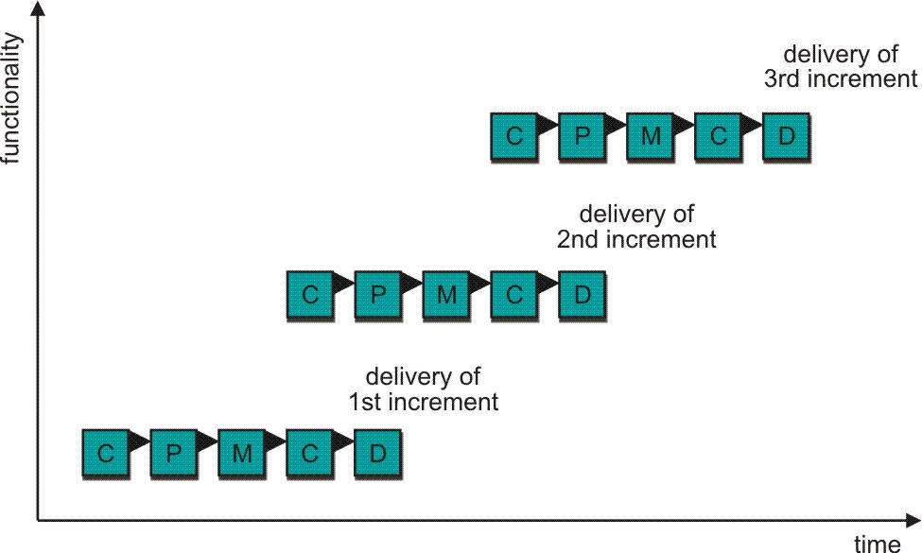
Incremental Process Model
C- Communication
P - Planning
M – Modeling
C - Construction
D - Deployment
Delivers software in small but usable pieces, each piece builds on pieces already delivered

Slide 24
The Incremental Model
Rather than deliver the system as a single delivery, the development and delivery is broken down into increments with each increment delivering part of the required functionality.
First Increment is often core product
Includes basic requirement
Many supplementary features (known & unknown) remain undelivered
A plan of next increment is prepared
Modifications of the first increment
Additional features of the first increment
It is particularly useful when enough staffing is not available for the whole project
Increment can be planned to manage technical risks.
Incremental model focus more on delivery of operation product with each increment.

Slide 25
The Incremental Model
User requirements are prioritised and the highest priority requirements are included in early increments.
Once the development of an increment is started, the requirements are frozen though requirements for later increments can continue to evolve.
Customer value can be delivered with each increment so system functionality is available earlier.
Early increments act as a prototype to help elicit requirements for later increments.
Lower risk of overall project failure.
The highest priority system services tend to receive the most testing.

Slide 26
Advantages
Rigid nature of sequential approach.
This method is great help when organization is low on staffing.
Generate working software quickly and early during the software life cycle.
More flexible – less costly to change scope and requirements.
Easier to test and debug during a small iteration.
Easier to manage risk because risky pierces are identified and handled during its iteration.
Each increment is an easily managed milestone.

Slide 27
Disadvantages
This model could be time consuming.
Each phase of an increment is rigid and do not overlap each other.
Problems may arise in system architecture, all the requirements are not gathered up entire software life cycle.

Slide 28
Evolutionary Process Model
Produce an increasingly more complete version of the software with each iteration.
Evolutionary Models are iterative.
Evolutionary models are:
Prototyping
Spiral Model
Concurrent Development Model

Slide 29
Evolutionary Models: Prototyping
Quick
plan
communication
Modeling
Quick design
Deployment
delivery &
feedback
Construction
of prototype
Construction
of prototype

Slide 30
Prototyping Model
Best approach when:
Objectives defines by customer are general but does not have details like input, processing, or output requirement.
Developer may be unsure of the efficiency of an algorithm, O.S., or the form that human machine interaction should take.
It can be used as standalone process model.
Model assist software engineer and customer to better understand what is to be built when requirement are fuzzy.
Prototyping start with communication, between a customer and software engineer to define overall objective, identify requirements and make a boundary.
Going ahead, planned quickly and modeling (software layout visible to the customers/end-user) occurs.
Quick design leads to prototype construction.
Prototype is deployed and evaluated by the customer/user.
Feedback from customer/end user will refine requirement and that is how iteration occurs during prototype to satisfy the needs of the customer.

Slide 31
Prototyping (cont..)
Prototype can be serve as “the first system”.
Both customers and developers like the prototyping paradigm.
Customer/End user gets a feel for the actual system
Developer get to build something immediately.
Problem Areas:
Developer often makes implementation in order to get a prototype working quickly without considering other factors in mind like OS, Programming language, etc.
Customer cries foul and demand that “a few fixes” be applied to make the prototype a working product, due to that software quality suffers as a result.
Customer and developer both must be agree that the prototype is built to serve as a mechanism for defining requirement.

Slide 32
Evolutionary Models: The Spiral

Slide 33
Spiral Model
Couples iterative nature of prototyping with the controlled and systematic aspects of the linear sequential model
It provide potential for rapid development of increasingly more complete version of the software.
Using spiral, software developed in as series of evolutionary release.
Early iteration, release might be on paper or prototype.
Later iteration, more complete version of software.
Divided into framework activities (C,P,M,C,D). Each activity represent one segment.
Evolutionary process begins in a clockwise direction, beginning at the center risk.
First circuit around the spiral might result in development of a product specification. Subsequently, develop a prototype and then progressively more sophisticated version of software.
Unlike other process models that end when software is delivered.
It can be adapted to apply throughout the life of software.

Slide 34
Spiral Model
Advantages:
It is realistic approach for development for large scale system
High amount of risk analysis
Good for large and mission-critical projects
Software is produced early in the software life cycle

Slide 35
Spiral Model
Disadvantages
It is not widely used.
Can be a costly to use
Risk analysis requires highly specific expertise.
Project’s success is highly dependent on the risk analysis phase.
Doesn’t work well for smaller projects.
It demands considerable risk assessment expertise and relies on this expertise for success.
It may be difficult to convince customers that the evolutionary approach is controllable.

Slide 36
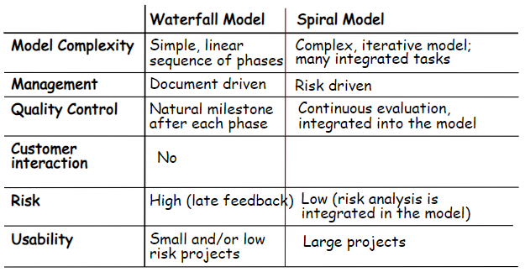
Waterfall vs Spiral Model

Slide 37
Evolutionary Models: Concurrent

Slide 38
Concurrent Development Model
It represented schematically as series of major technical activities, tasks, and their associated states.
It is often more appropriate for system engineering projects where different engineering teams are involved.
The activity-modeling may be in any one of the states for a given time.
All activities exist concurrently but reside in different states.
E.g.
The analysis activity (existed in the none state while initial customer communication was completed) now makes a transition into the under development state.
Analysis activity moves from the under development state into the awaiting changes state only if customer indicates changes in requirements.
Series of event will trigger transition from state to state.
E.g. During initial stage there was inconsistency in design which was uncovered. This will triggers the analysis action from the Done state into Awaiting Changes state.

Slide 39
Evolutionary Processes
The first concern is that prototyping poses a problem to project planning.
Evolution Processes do not establish the maximum speed of evolution.
The Evolution Processes should be focused on flexibility and extendibility than on high quality,

Slide 40
Still Other Process Models
Component based development—the process to apply when reuse is a development objective
Unified Process—a “use-case driven, architecture-centric, iterative and incremental” software process closely aligned with the Unified Modeling Language (UML)
Formal methods—emphasizes the mathematical specification of requirements
AOSD—provides a process and methodological approach for defining, specifying, designing, and constructing aspects

Slide 41
Component Based Development
component-based development (CBD) model incorporates many of the characteristics of the spiral model.
It is evolutionary by nature and iterative approach to create software.
CBD model creates applications from prepackaged software components (called classes).

Slide 42
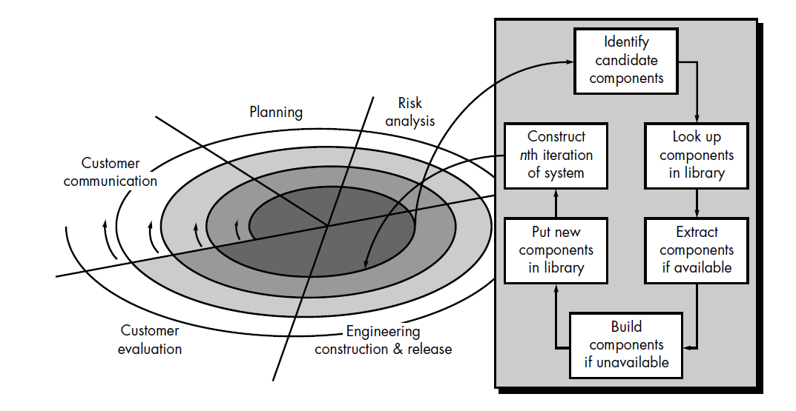
SDLC: Component Based Development

Slide 43
CBD model (cont.)
Modeling and construction activities begin with identification of candidate components.
Classes created in past software engineering projects are stored in a class library or repository.
Once candidate classes are identified, the class library is searched to determine if these classes already exist.
If class is already available in library extract and reuse it.
If class is not available in library, it is engineered or developed using object-oriented methods.
Any new classes built to meet the unique needs of the application.
Now process flow return to the spiral activity.

Slide 44
CBD model (cont.)
CBD model leads to software reusability.
Based on studies, CBD model leads to 70 % reduction in development cycle time.
84% reduction in project cost.
Productivity is very high.

Slide 45
Unified Process
Good Start => Unified Process (UP) is a standard development process within the object-oriented and component-based software communities.
Product => Rational Unified Process (RUP)
More Needed => Enterprise Unified Process (EUP) is a software process that reflects the full lifecycle of software-based systems.

Slide 46
3 Key Aspects of UP
Use-case driven
Architecture-centric
Iterative and incremental

Slide 47
Use-Case Driven
Use-Case driven means:
Development process proceeds through a series of workflows that derive from use cases.

Slide 48
3 Terminologies
Users: someone or something that interact with system.
Use Case: interaction between users and system,---what is the system supposed to do for each user?
Use Case Model: collection of use cases; description of complete functionality

Slide 49
Initiate AND bind
Tool for specifying requirements
Driving design
Source for testing

Slide 50
II. Architecture-Centric
Architecture is the view of the whole design with key Characteristics and without too many details
Only 5-10% use cases
growth with use case in parallel (structure and function)

Slide 51
Use case & Architecture
Use case
drive
influence
System architecture

Slide 52
III. Iterative and Incremental ??
Iteration: Steps in the workflow (mini-project)
Create a design for relevant use cases
Implement with components
Required iteration in logical order for economy
Increments: Growth in the product (might not be additive)

Slide 53
Benefits to controlled iteration
Reduce the cost risk to the expenditures on a single increment
Reduce the risk of delayed product delivery (find the risks earlier)
Speed up the tempo of the whole development effort
Easier to adapt to the requirement modification

Slide 54
The Unified Process (UP)
elaboration
inception

Slide 55
UP Phases

Slide 56
UP Work Products

Slide 57
Inception Phase
Encompasses both customer communication and planning activities of the generic process
Business requirements for the software are identified
A rough architecture for the system is proposed
A plan is created for an incremental, iterative development
Fundamental business requirements are described through preliminary use cases
A use case describes a sequence of actions that are performed by a user
57

Slide 58
Elaboration Phase
Encompasses both the planning and modeling activities of the generic process
Refines and expands the preliminary use cases
Expands the architectural representation to include five views
Use-case model
Analysis model
Design model
Implementation model
Deployment model
Often results in an executable architectural baseline that represents a first cut executable system
The baseline demonstrates the viability of the architecture but does not provide all features and functions required to use the system
58

Slide 59
Construction Phase
Encompasses the construction activity of the generic process
Uses the architectural model from the elaboration phase as input
Develops or acquires the software components that make each use-case operational
Analysis and design models from the previous phase are completed to reflect the final version of the increment
Use cases are used to derive a set of acceptance tests that are executed prior to the next phase
59

Slide 60
Transition Phase
Encompasses the last part of the construction activity and the first part of the deployment activity of the generic process
Software is given to end users for beta testing and user feedback reports on defects and necessary changes
The software teams create necessary support documentation (user manuals, trouble-shooting guides, installation procedures)
At the conclusion of this phase, the software increment becomes a usable software release
60

Slide 61
Production Phase
Encompasses the last part of the deployment activity of the generic process
On-going use of the software is monitored
Support for the operating environment (infrastructure) is provided
Defect reports and requests for changes are submitted and evaluated
61

Slide 62
UP strengths
Strength of RUP:
Based on sound SWE principles
Mechanisms that provide management visibility into the development process
HTML-based description of the RUP

Slide 63
UP weaknesses
Only developing process, not the entire software process
Not supporting multi-system infrastructure development efforts
Iterative nature foreign to experienced developers
Tool-driven approach, not sufficient for complex system

Slide 64
Unified Process Work Products
Work products are produced in each of the first four phases of the unified process
In this course, we will concentrate on the analysis model and the design model work products
Analysis model includes
Scenario-based model, class-based model, and behavioral model
Design model includes
Component-level design, interface design, architectural design, and data/class design
64
☺

Slide 65
Workflows of the UP
A workflow is a sequence of activities that produces a result of discernible value. In the UP, there are nine core process workflows. They are:
Business Modeling Workflow
Requirements Workflow
Design Workflow
Implementation Workflow
Test Workflow
Deployment Workflow
Project Management Workflow
Configuration and Change management Workflow
Environment Workflow

Slide 66
Business Modeling Workflow
Main aim: Evolve a common understanding among various stakeholders about what the project will deliver.
Unified Process provides a common language and process for various stakeholders.

Slide 67
Requirements Workflow
The aim: To achieve the above task by eliciting the functional requirements as well as the constraints.
A document describing the vision and scope of the project is created.
Actors and use cases are identified and described in detail.
The constraints are also documented.

Slide 68
Design Workflow
The main aim : Deliver the design model.
The identification and validation of core architecture is done in an iterative manner.
Initially, only the core architectural design is done without paying much attention to details.
This is followed by detailed design of the core architecture.
Other facets of the design like the databases, networking etc. are also designed.

Slide 69
Implementation Workflow
Main aim:To program and build the system.
Unit tests are also carried out and the unit-tested units are integrated into a complete system.

Slide 70
Test Workflow
Actually, testing is done throughout the project in an iterative manner.
Testing includes
the verification whether software has been developed according to the user requirements and
whether the components of the software are properly integrated and defects addressed prior to the deployment of the software.

Slide 71
Project Management Workflow
The aim: To simplify these tasks by providing a framework for managing the overall project, managing risks and providing guidelines for formulating a project plan, allocating staff and monitoring the course of the project.
To manage a software project, it is necessary for the project manager to
Manage risks,
Overcome difficulties in course of the project,
Balance the objectives of different people and
Ultimately deliver a product to the customer of high quality, reasonable cost and within the estimated schedule.

Slide 72
Configuration and Change Management Workflow
Gives guidelines on how to manage the various problems that are inherent when teamwork is performed.
Guidelines can be in regard to:
Maintaining different variants of software,
Enforcing organizational development policies,
Managing change requests,
Tracking changes and
Keeping an audit of the changes made.

Slide 73
Environment Workflow
Main aim: To provide the software development organization the processes and the tools that are needed to support the development team.
A detailed guide is provided to implement a customized process for a particular project in the organization.

